Slide 1

CSCI/ARTI 8950 Machine Learning
Lecture Notes 10: Bias and Fairness
Khaled Rasheed
Professor
School of Computing
Member
Institute for Artificial Intelligence
University of Georgia
Credit: some examples & figures by Marine Carpuat, Tom Mitchell and Hal Daumé III

Slide 2
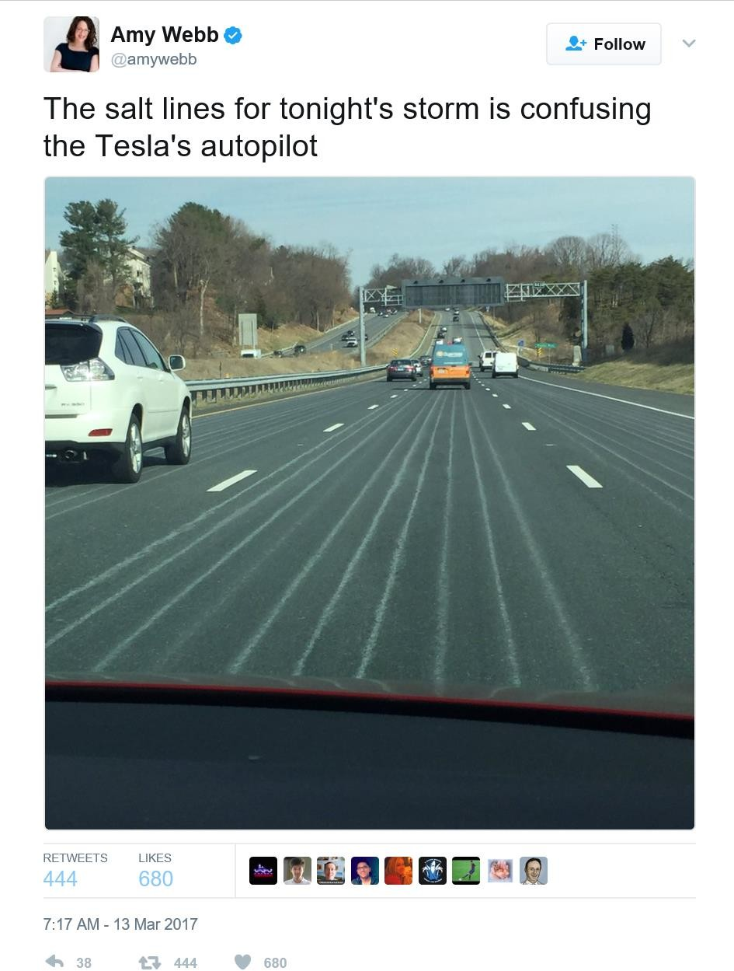

Slide 3
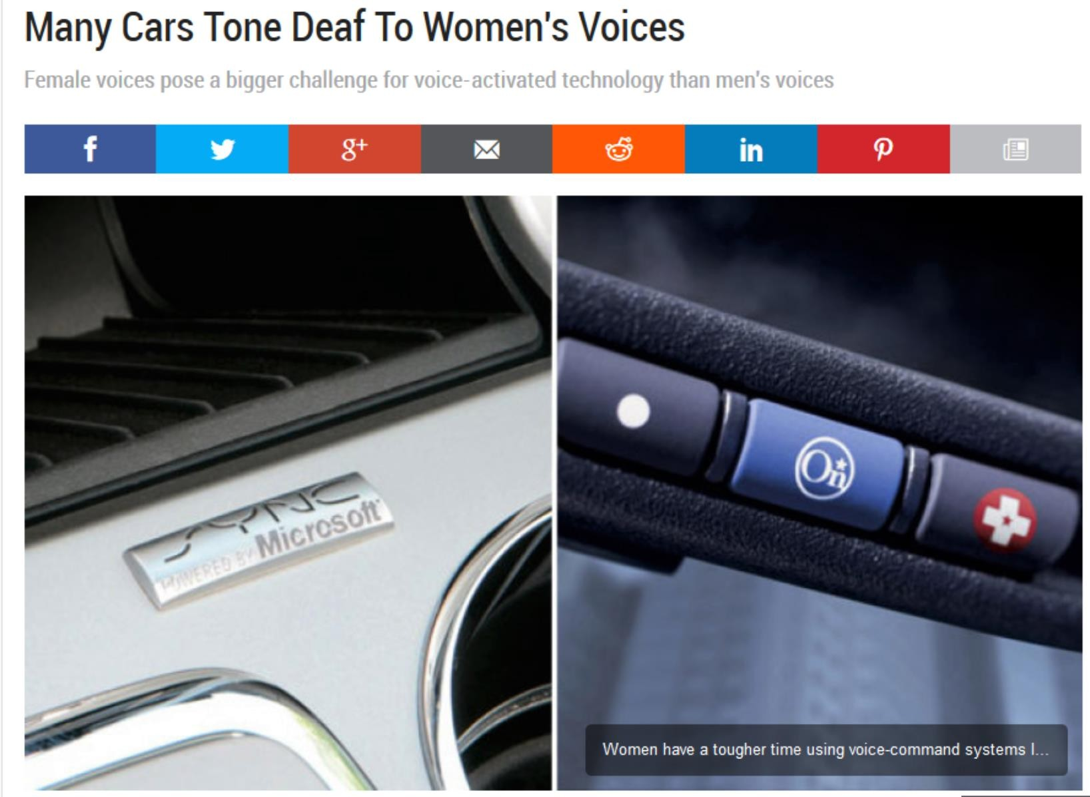
http://www.autoblog.com/2011/05/31/women-voice-command-systems/

Slide 4
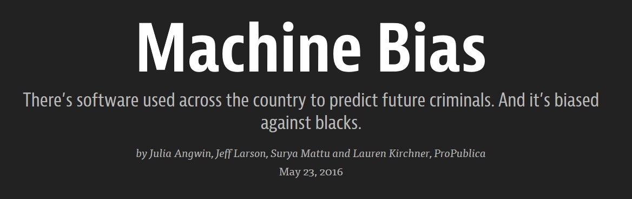
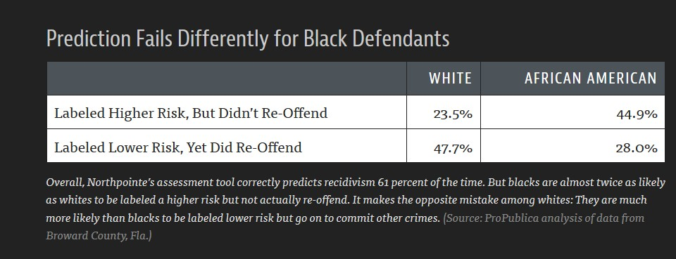
https://www.propublica.org/article/machine-bias-risk-assessments-in-criminal-sentencing

Slide 5
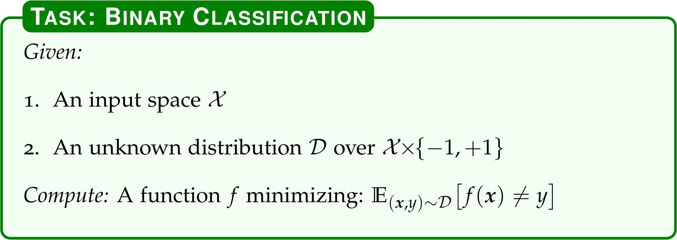
Recall: Formal Definition of Binary Classification (from CIML)

Slide 6
Train/Test Mismatch
When working with real world data, training sample
reflects human biases
is influenced by practical concerns
e.g., what kind of data is easy to obtain
Train/test distribution mismatch is frequent issue
aka sample selection bias, domain adaptation

Slide 7
Domain Adaptation
What does it mean for 2 distributions to be related?
When 2 distributions are related how can we build models that effectively share information between them?

Slide 8



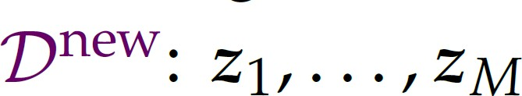
Unsupervised adaptation
Goal: learn a classifier f that achieves low expected loss under new distribution
Given labeled training data from old distribution
And unlabeled examples from new distribution

Slide 9
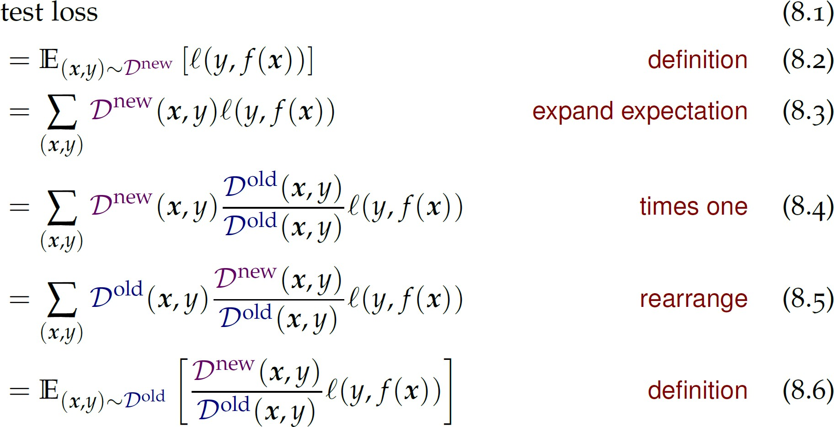
Relation between test loss in new domain and old domain

Slide 10
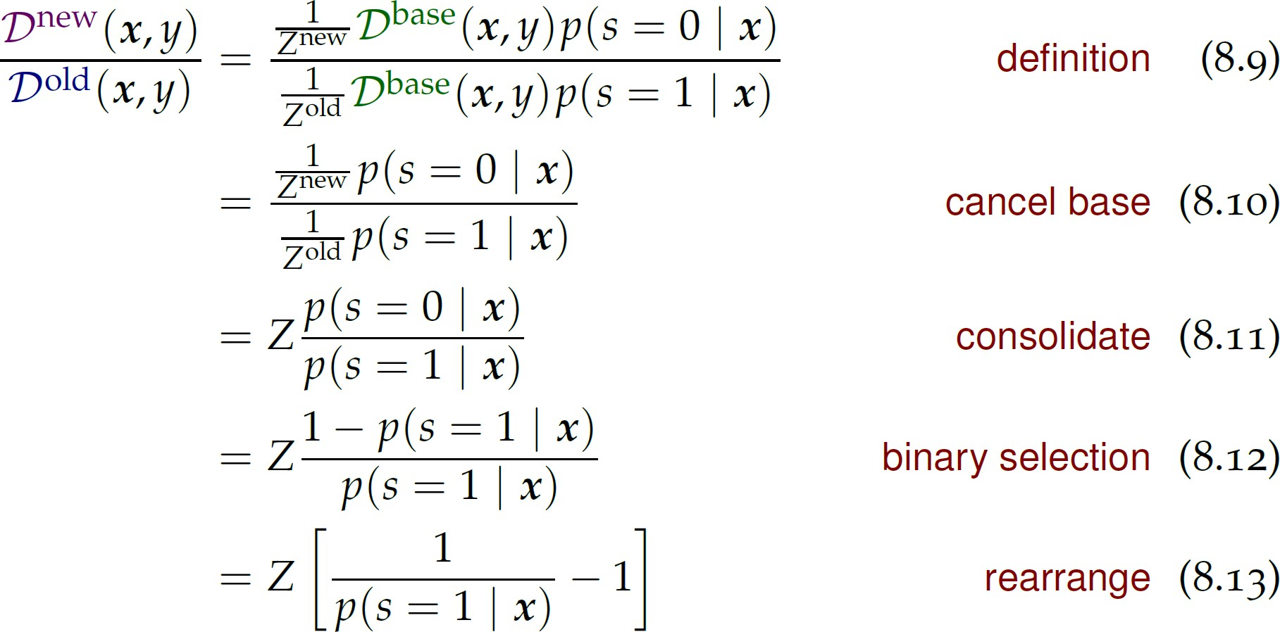
How can we estimate the ratio between Dnew and Dold?
Fixed base
distribution
S = selection variable
We can estimate P(s=1|x) using a binary classifier!

Slide 11
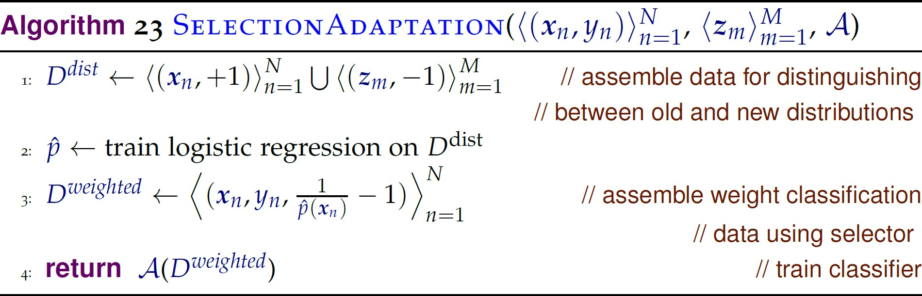

Slide 12


Supervised adaptation
Goal: learn a classifier f that achieves low expected loss under new distribution
Given labeled training data from old distribution
And labeled examples from new distribution

Slide 13
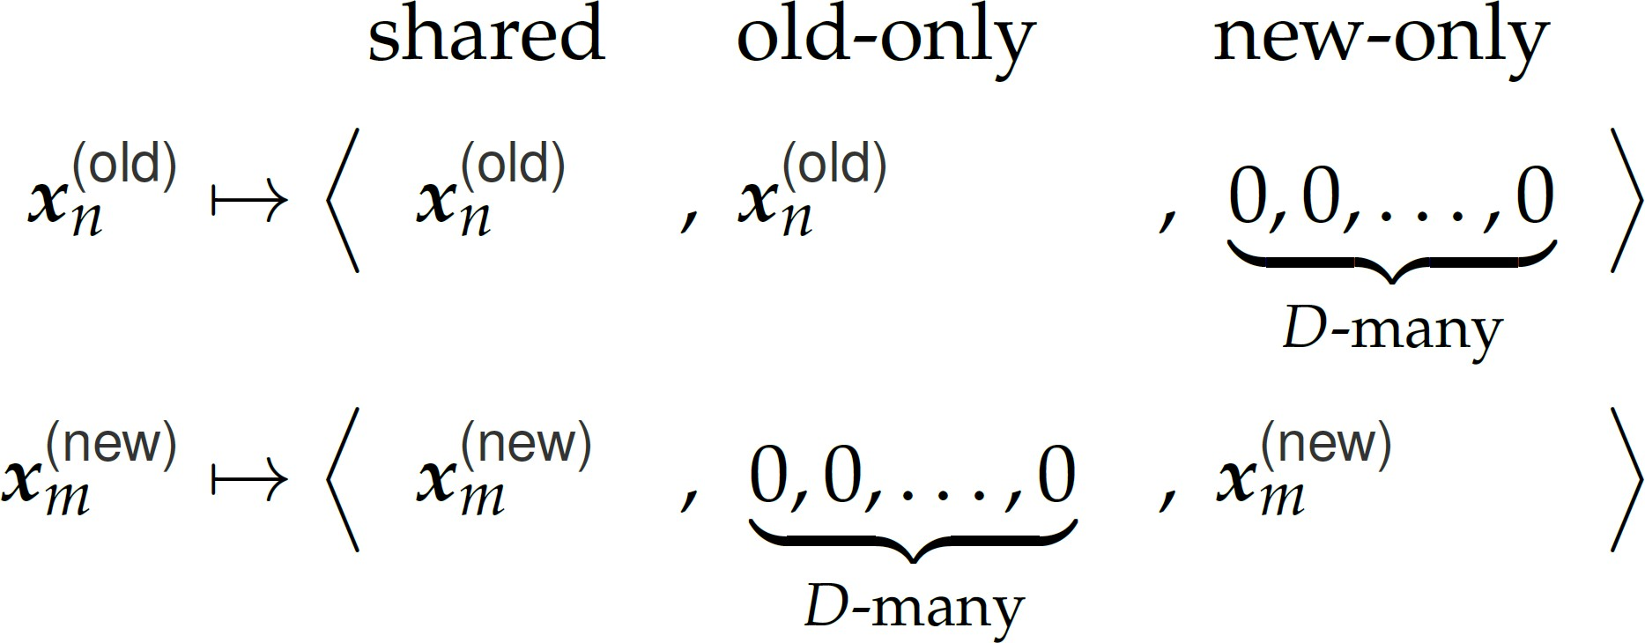
One solution: feature augmentation
Map inputs to a new augmented representation

Slide 14
One solution: feature augmentation
Transform Dold and Dnew training examples
Train a classifier on new representations
Done!

Slide 15
One solution: feature augmentation
Adding instance weighting might be useful if N >> M
Most effective when distributions are “not too close but not too far”
– In practice, always try “old only”, “new only”, “union of old and new” as well!

Slide 16
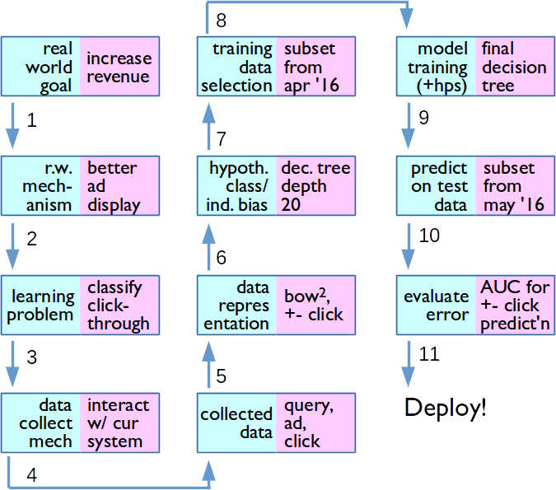
Typical Design Process for an ML Application

Slide 17
Bias is pervasive
Bias in the labeling
Sample selection bias
Bias in choice of labels
Bias in features or model structure
Bias in loss function
Deployed systems create feedback loops

Slide 18
ACM Code of Ethics
“To minimize the possibility of indirectly harming others, computing professionals must minimize malfunctions by following generally accepted standards for system design and testing. Furthermore, it is often necessary to assess the social consequences of systems to project the likelihood of any serious harm to others. If system features are misrepresented to users, coworkers, or supervisors, the individual computing professional is responsible for any
resulting injury.”
https://www.acm.org/about-acm/acm-code-of-ethics-and-professional-conduct

Slide 19
Bias and how to deal with it
Train/test mismatch
Unsupervised adaptation
Supervised adaptation

